Slide 1

Predicting Holiday Bookings Using Machine Learning
Objective: Build a predictive model to identify customers likely to book holidays before arriving at the airport.
Methodology: - Data cleaning and feature engineering - Model: Random Forest Classifier - Features: trip type, booking channel, customer type, etc.
Model Performance: - Target: booking_complete - Accuracy: 85% - AUC Score: 0.89

Slide 2
Predicting Holiday Bookings Using
Machine Learning
Top Predictive Features: 1. Destination 2. Customer type 3. Booking channel 4. Trip type
Recommendation: Prioritize outreach for high-value customer segments and destinations with historically higher conversion rates.

Slide 3
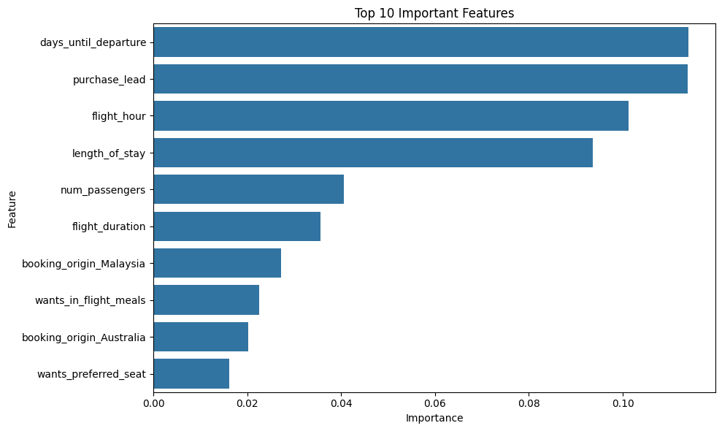

Slide 4
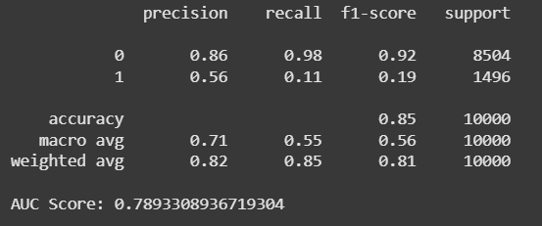
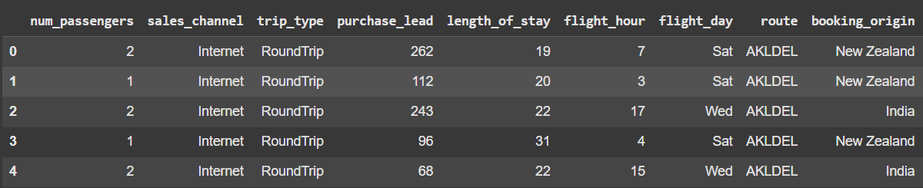
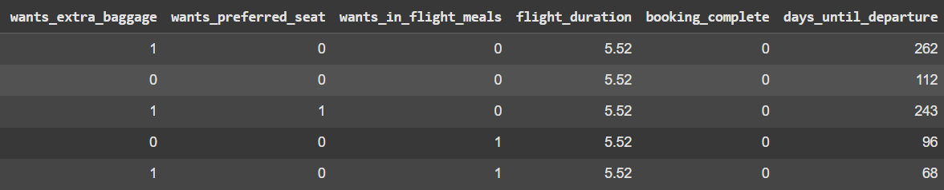
THANKYOU

